Slide 1


NovaX
Menu
About Us
Detecting Oil spills at marine environment using AIS and satellite datasets
Theme :Artificial Intelligence & Environmental Sustainability
Team Team NovaX
Team leader: Simon Jaques Mascarenhas J ( Dept of ECE)

Slide 2


NovaX
Team Details
Simon Jaques Mascarenhas J 210425106222 ECE 2nd yr
Manickavel C 210425106117 ECE 2nd yr
Dhinesh Karthick 210425106049 ECE 2nd yr
Easwarnath Jeyaram K 210425106050 ECE 2nd yr

Slide 3
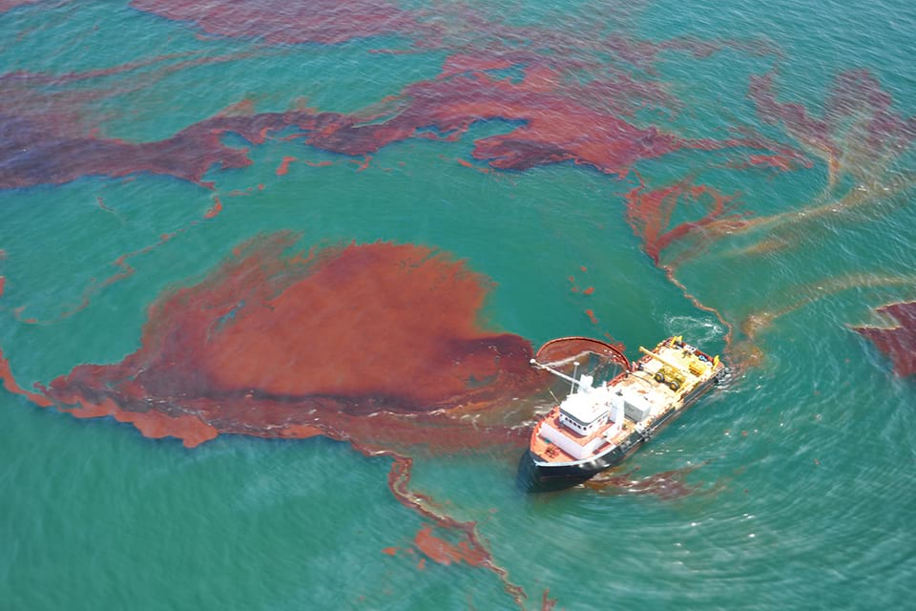

NovaX
Problem statement
Oil spills cause serious damage to marine ecosystems, fisheries, and coastal regions.
Vast ocean areas make rapid and continuous detection difficult.
Identifying the spill source and responsible vessel is challenging.
Ocean currents and weather conditions make spill movement unpredictable.
Delayed detection can lead to greater environmental and economic damage.

Slide 4



NovaX
Proposed solution
Detect
AI-based oil-spill detection from SAR satellite imagery
Map
GIS-based spill location, extent & confidence mapping
Trace
AIS data to identify nearby vessels & potential spill sources
.
An AI-powered end-to-end system for detecting, analyzing, tracing, and predicting marine oil spills.
Predict
Ocean currents + weather data to predict spill drift & affected areas
Assess
Estimate spill severity, environmental impact & risk
Respond
Agentic AI combines all evidence to generate alerts, insights & recommended actions
Satellite + AI + AIS + GIS + Ocean/Weather Intelligence → Actionable Oil-Spill Intelligence

Slide 5
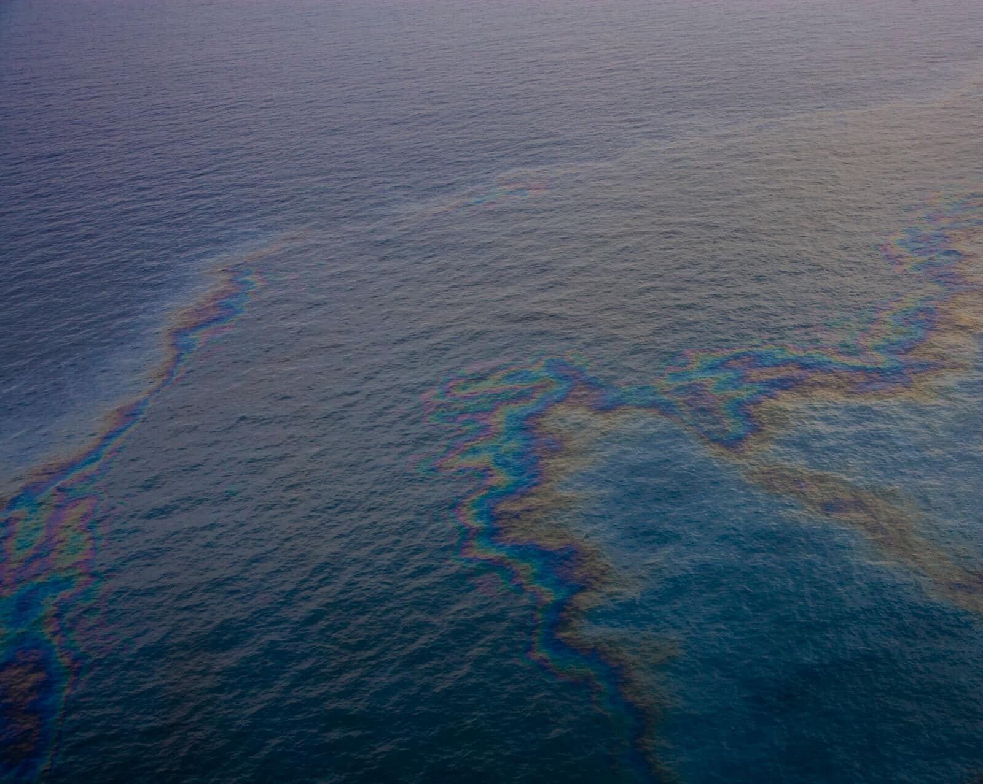

NovaX
Architecture and implementation
Intelligence & Analysis
Map spills, correlate with vessels,
and predict drift.
AI Detection
Agentic AI
Use MobileNetV2 to classify oil
Fuse evidence and reason across
spills and assess severity.
sources for incident analysis.
Data Preprocessing
Output
Clean and synchronize data for AI
Generate spill maps, identify
analysis.
potential sources, and provide
alerts.
Data Sources
Gather diverse data like SAR satellite
images, AISvessel data, and weather
information.

Slide 6
NovaX
Feasability and Viability
Technical: Uses proven AI, satellite, AIS, GIS and cloud technologies.
Data: Satellite, AIS, weather and ocean datasets are accessible for development.
Cost: Software-first approach reduces dependence on expensive physical monitoring.
Operational: Automates spill detection, source analysis and risk assessment.
Scalable: Can expand from local monitoring to large-scale marine surveillance.
Impact: Enables faster detection, better source tracing and earlier environmental response.

Slide 7
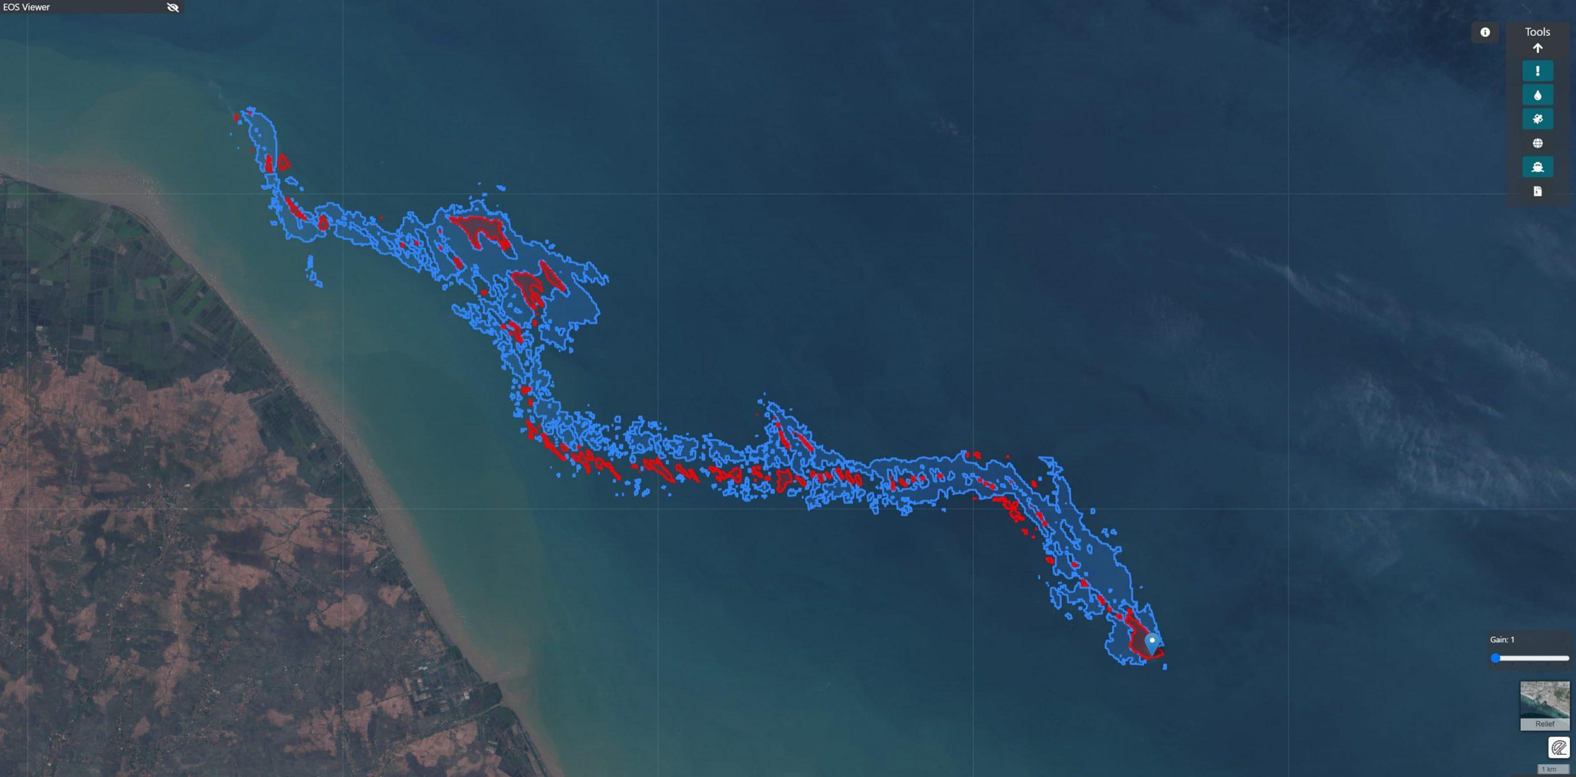
NovaX
Impact and benefits
Early Detection — Faster identification of marine oil spills.
Source Identification — Correlates AIS data to identify potential responsible vessels.
Drift Prediction — Predicts spill movement and potentially affected regions.
Better Monitoring — GIS-based visualization of spill extent and risk.
Faster Response — Automated risk assessment and alerts support timely action.
Environmental Protection — Helps reduce damage to coastlines and sensitive marine ecosystems.
Cost Efficient — Enables large-area monitoring without relying solely on physical surveillance.

Slide 8

NovaX
Business models and revenue streams
B2G – Government & Coastal Authorities
Subscription-based oil-spill monitoring and early-warning platform.
B2B – Maritime & Shipping Companies
Vessel-risk monitoring, compliance insights and environmental analytics.
API / Data Services
Paid access to spill detections, risk scores, GIS layers and predictive data.
Enterprise Platform
Customized dashboards, integrations and large-scale monitoring for organizations.
Premium Analytics
Advanced vessel-source correlation, drift prediction and environmental risk reports.
Revenue Model
SaaS Subscription + API Licensing + Enterprise Contracts + Custom Analytics
Challenge: Fluctuations in

Slide 9
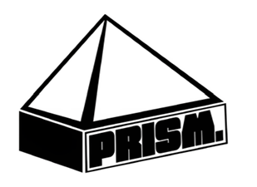

ginyard
Research and Referenece
Bianchi, F. M., Espeseth, M. M., & Borch, N. (2020)
Large-Scale Detection and Categorization of Oil Spills from SAR Images with Deep Learning.
Remote Sensing
Shaban, M. et al. (2021)
A Deep-Learning Framework for the Detection of Oil Spills from SAR Data.
Sensors
Hasimoto-Beltran, R. et al. (2023)
Ocean Oil Spill Detection from SAR Images Based on Multi-Channel Deep Learning Semantic Segmentation.
Marine Pollution Bulletin
Luo, D. et al. (2024)
A New Ship Tracing Technology from Oil Spills Based on Multi-Source Data.
Marine Pollution Bulletin
Prasad, S. J. et al. (2019)
Oil Spill Trajectory Prediction with High-Resolution Ocean Currents.
Journal of Operational Oceanography

Slide 10
NovaX
Thank you
🔗 GitHub Repository

